Slide 1
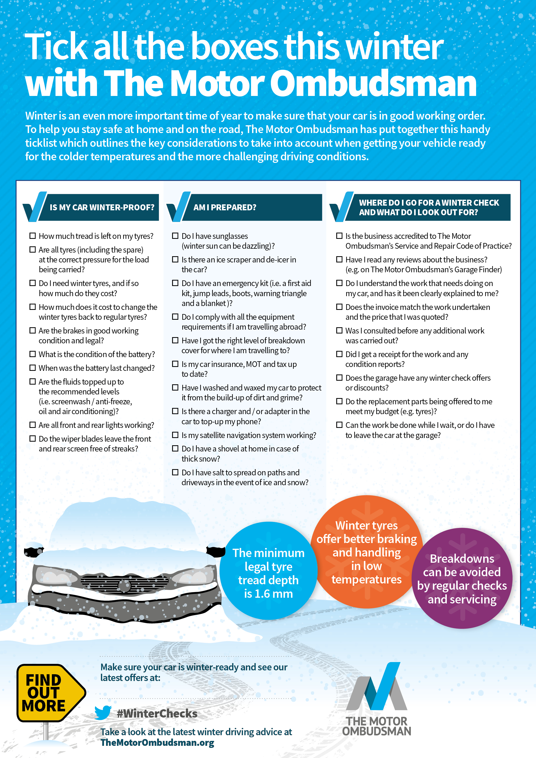
[Insert your website address here]
Insert your logo here
(and delete this box)

