Slide 1
Automotive Law update – December 2018
Law innovated

Slide 2
What are the Legal changes that are having the biggest impact on the automotive sector now and into 2019?
Bill Fennell Managing Director & Chief Ombudsman The Motor Ombudsman Iain Larkins Founder & Head of the Automotive Practice Radius Law
Law innovated

Slide 3
Agenda
About The Motor Ombudsman & Radius Law
Energy consumption and emissions – WLTP
Consumer legislation
Financial services Competition law
Employment
Advertising and marketing – ASA ruling
Automated vehicles
Data security
Corporate governance
Questions & Answers
Law innovated

Slide 4
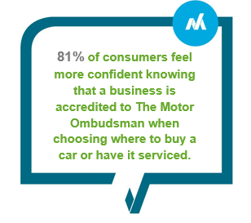
The Motor Ombudsman
The first and only Ombudsman for the automotive industry
A clear channel and point of contact for all motoring-related disputes
Self-regulates the UK’s motor industry through its comprehensive Chartered Trading Standards Institute (CTSI)-approved Codes of Practice
Thousands of businesses accredited to one or more of the Codes covering new cars, sales, vehicle warranties, and servicing and repair.
Law innovated

Slide 5
Radius Law
An automotive specialist law firm
Established by the former Chief Legal Officer of Mercedes-Benz UK, Iain Larkins
The only law firm to have its GDPR services endorsed by the Motor Ombudsman and the MCIA
A modern firm that utilises the latest legal tech and promises to never use legalese
Law innovated

Slide 6
Housekeeping points
During the webinar everyone will be muted so that only the presenters can be heard.
The presentation will be followed by a Q&A session.
You can type your questions throughout the webinar. Click on the chat button.
All questions relevant to the topic will be answered at the Q&A session. Any other questions will be addressed as we go along.
If you are experiencing any technical problems please call or message: 07557 433 602.
Law innovated

Slide 7
Energy consumption and emissions
WLTP
New mandatory consumer information to be provided from January 2019;
WLTP mandatory for all vans from September 2019.
New proposed UK law to hold vehicle importers and dealer-distributors to account if vehicles are sold with emissions defeat devices.
Law innovated

Slide 8
Consumer
Recalls
Motor manufacturer & DVSA criticised for management of a recall;
New Code of Practice for product recalls.
Government consultation on Modernising Consumer Markets and the EU New deal for consumers.
Government and automotive organisations tackle counterfeit parts.
Distance selling terms.
Law innovated

Slide 9
Financial Services
38 Final notices issued to dealers in 2018;
New FCA rules relating to assessing creditworthiness – November 2018;
FCA warns Motor Finance firms to comply with financial promotion rules in social media advertisements – November 2018;
FCA automotive final report expected by end of 2018;
Admiral Car Finance recent report has revealed that just 1 in 10 people understand common industry terminology.
Law innovated

Slide 10
Competition laws
Truck cartel class action may exceed £5bn;
2018 CMA Awareness study
16% of UK businesses have never heard of competition law;
nearly half didn’t know or thought it was legal to discuss prices with competitors;
59% thought that dividing or sharing customers was legal;
Only 6% have provided competition law training.
Geo-blocking laws – prohibits unjustified discrimination on the grounds of nationality, place of residence or place of establishment in the EU;
Internet sales
Ping Europe – Retailers must be able to sell on own websites;
Coty – Retail sales of luxury products on third party websites may be prohibited.
Law innovated

Slide 11
Employment
Apprentice Levy;
Equal pay claims & Gender Pay Gap;
Gig economy cases.
Law innovated

Slide 12
Advertising and Marketing
ASA bans Car People advert ‘Quality checked by eight specialists’;
ASA bans VW add for encouraging ‘irresponsible driving’;
Pendragon £144,000 fine for failing to disclose ex-rental car history.
Law innovated

Slide 13
Automated vehicles
Law Commission consultation paper on Automated Vehicles, Consultation closes on the 8th February 2019
Automated and Electric Vehicles Act 2018.
Law innovated

Slide 14
Data Security
Prison sentence for car repair employee who stole customer data.
Average fine for a data breach has doubled in the last year to £146,000 and the total value of penalties rose to £4.98 million, up 24% from £4 million the year before.
Morrisons data leak case – Employers can be liable for rogue employees.
ICO takes enforcement action for non payment of fees.
Planned changes to the ePrivacy Regulation in 2019.
Law innovated

Slide 15
Corporate Governance
New annual corporate governance reporting requirements will apply to financial years on or after 1 January 2019.
Law innovated

Slide 16
Thank you for taking the time to participate in todays webinar
business@tmo-uk.org www.themotorombudsman.org
020 7344 1651
iain.larkins@radiuslaw.co.uk www.radiuslaw.co.uk
01727 808503, 07767 886253
Law innovated

Slide 17
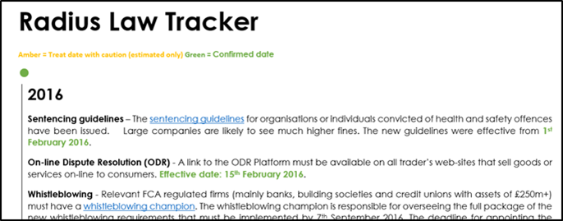
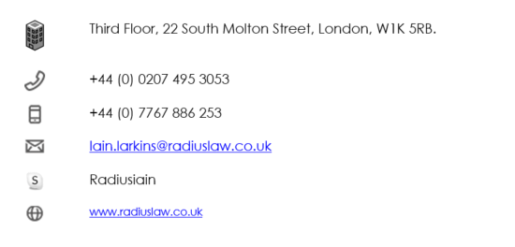
Radius Law keeping you up to date Iain Larkins, Director, Radius Law Limited
Notes:
Text

Slide 18
Notes:
The Advertising Standards Authority (ASA) has banned a Volkswagen television advert after it ruled that it encouraged irresponsible driving by exaggerating the benefits of a vehicle’s safety features.
The ad then showed them driving through a residential area and suddenly braking to a halt to avoid a pedestrian who had walked into the middle of the road. An alert feature flashed on the dashboard behind the steering wheel. The father appeared to be relieved and taps the dashboard. As the car drove on, on-screen text stated “For life’s adventurers….We make the future real”.

